Slide 1
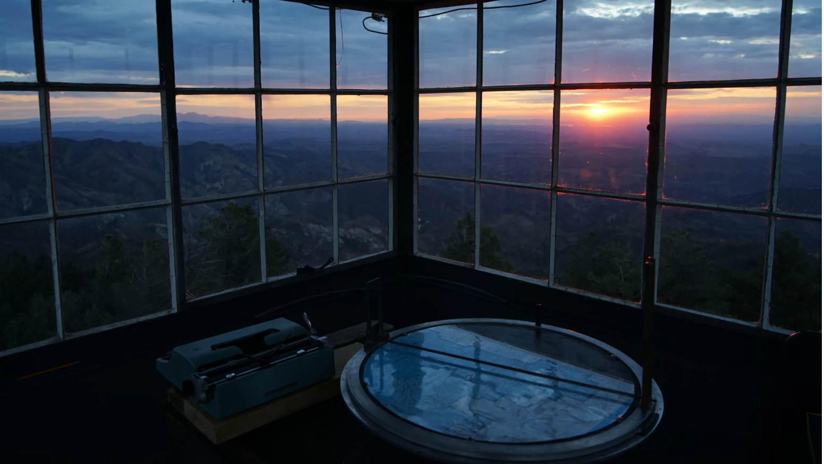

EARLY WILDFIRE DETECTION
using Machine Learning
Notes:
Wildfires in California have become larger, more frequent and more destructive in the last decade as a result of increased fuel buildup in our forests, denser populations in the wildland urban interface and drought conditions. With this project, I wanted to explore whether machine learning could help with the early detection of wildfires.

Slide 2
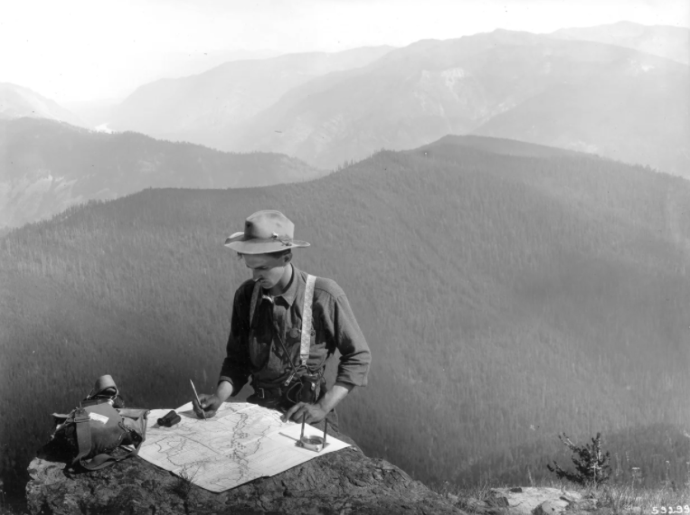
Human Lookouts
A THING OF THE PAST
Traditional fire lookouts are being phased out in favor of faster and safer fire-detection methods.
California once had 660 fire lookout towers/cabs that were manned for decades by personnel monitoring for wildfires. Since the 1990’s most of them have been retired from service as various terrestrial, aerial, and satellite-based technologies that are equipped with visible, IR, or multispectral sensors have become more commonplace. Today, only 38 of those towers remain in operation, mostly in our far northern forests.
Notes:
California used to rely on human fire spotters and had 660 manned fire lookout towers across the state. But these have been replaced with technology and remote monitoring and now there are only 38 active fire watch towers in California.

Slide 3
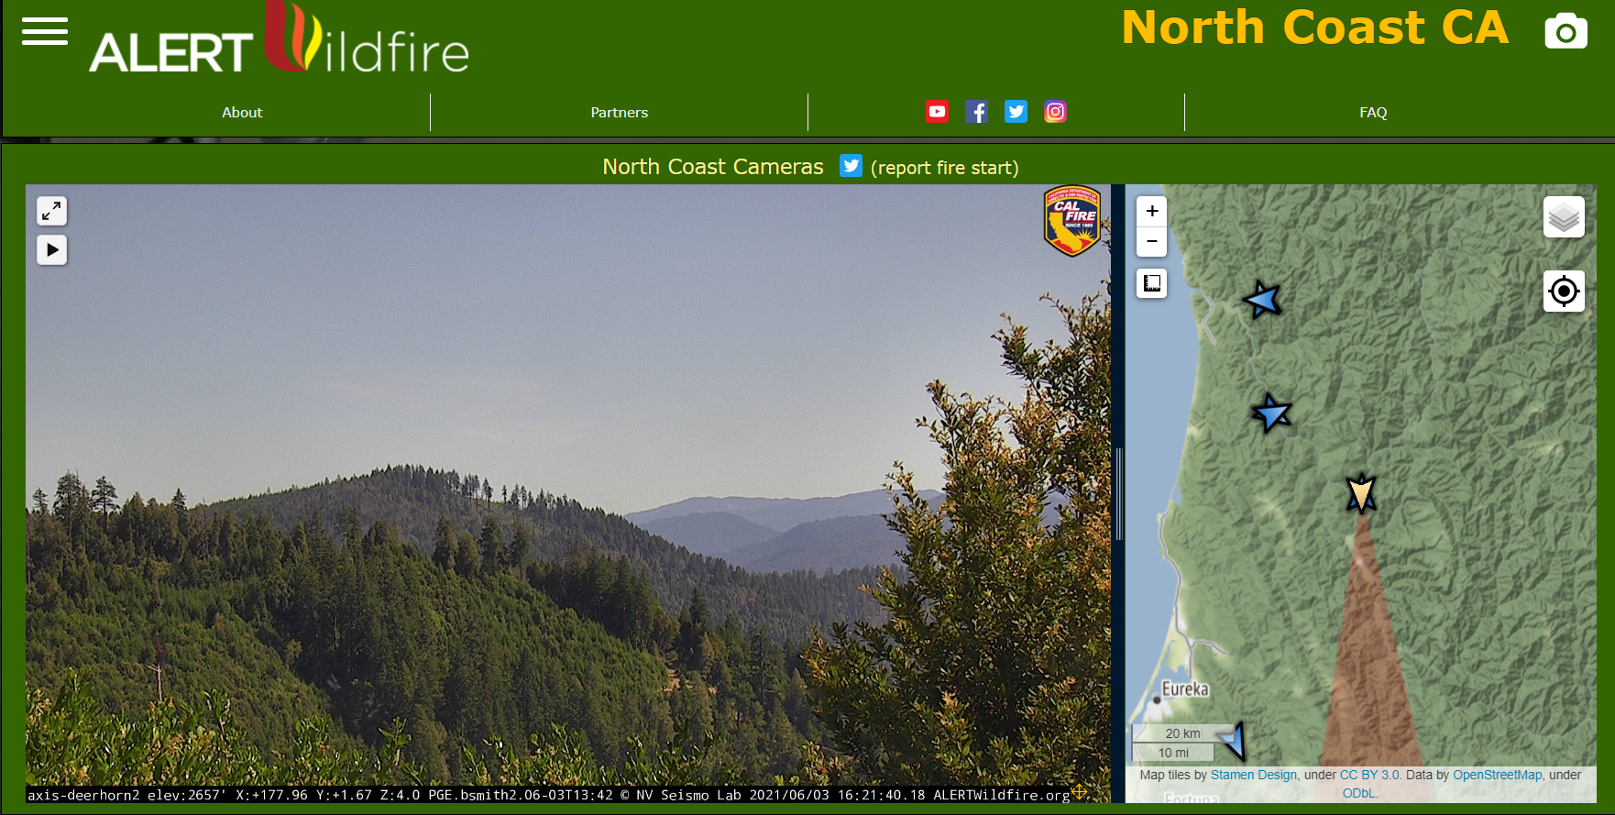
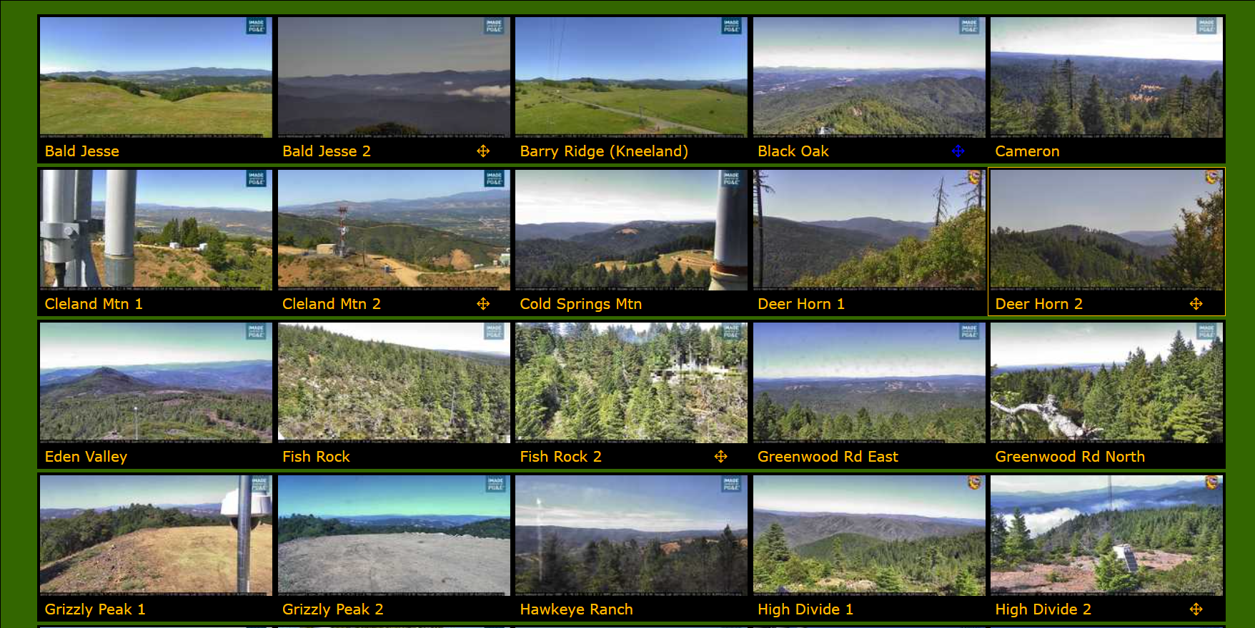
ALERT
Wildfire
NETWORK OF CAMERAS
Over the last decade, 800 PTZ (Pan-Tilt-Zoom) fire cameras have been installed across California by the HPWREN and ALERTWildfire consortiums:
https://hpwren.ucsd.edu/
http://www.alertwildfire.org/
These cameras are monitored by firefighters and the general public to detect wildfire ignition, verify & locate reported fires, and monitor wildfire behavior.
The cameras have proven highly effective for verifying and monitoring - over the last 5 years they have provided critical information for over 500 wildfires. But for people to manually detect fires using these cameras requires that they stare at them for hours on end looking for gradual changes…..a task much better suited to computers!
Notes:
One of the technologies in use today is ALERT Wildfire. This network has over 800 pan-tilt-zoom cameras for fire watching. Wildfire professionals operate these cameras in patrol mode and the public can monitor the cameras and send notifications if they spot a potential wildfire. One of the Fire Chiefs in SoCal working closely with ALERT Wildfire says that this system can shave off 20 minutes to an hour of the time it takes for him to initially respond to a fire.

Slide 4
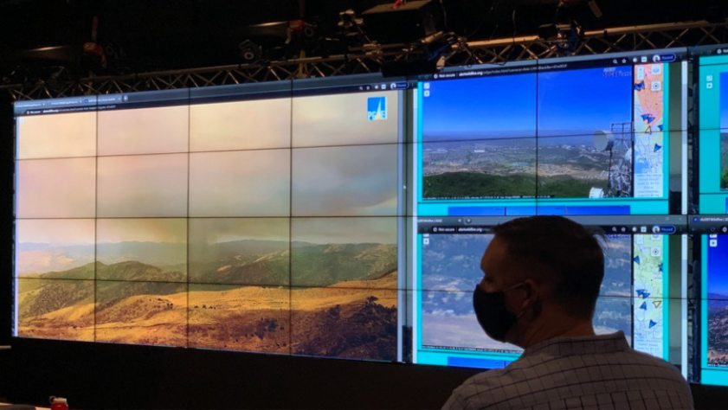
CAN WE AUTOMATE EARLY WILDFIRE DETECTION USING
MACHINE LEARNING?
Let’s find out!
Notes:
And while the system is good for verifying 911 wildfire calls & monitoring fires, it still relies on people to report these initial sightings. Wildfire professionals use it to verify, locate and monitor reported fires. In order to spot new wildfires breaking out, they would need to stare constantly at these cameras 24x7. This is a task much better suited to a computer. So I set out to see if we could use machine learning to automate the early detection of wildfires and alert the humans.

Slide 5

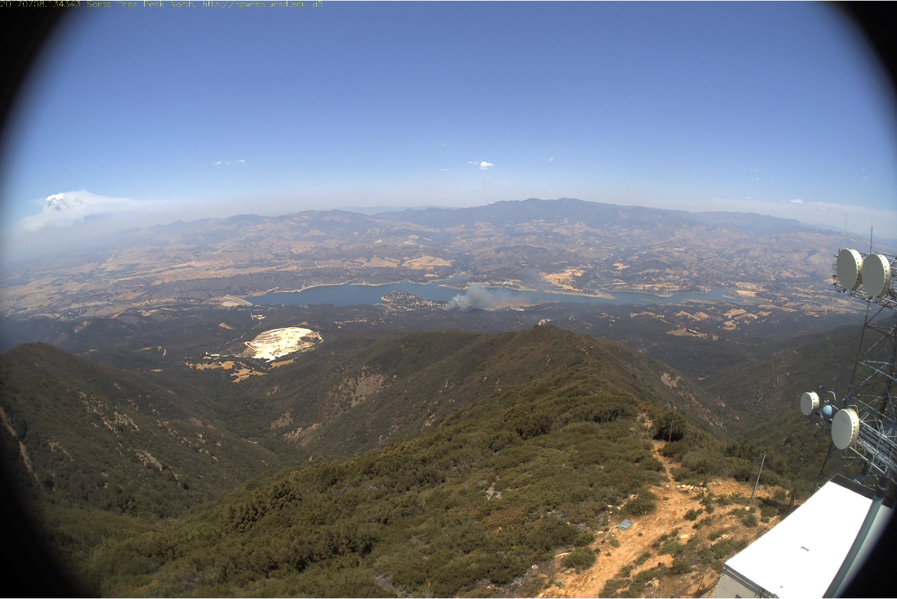

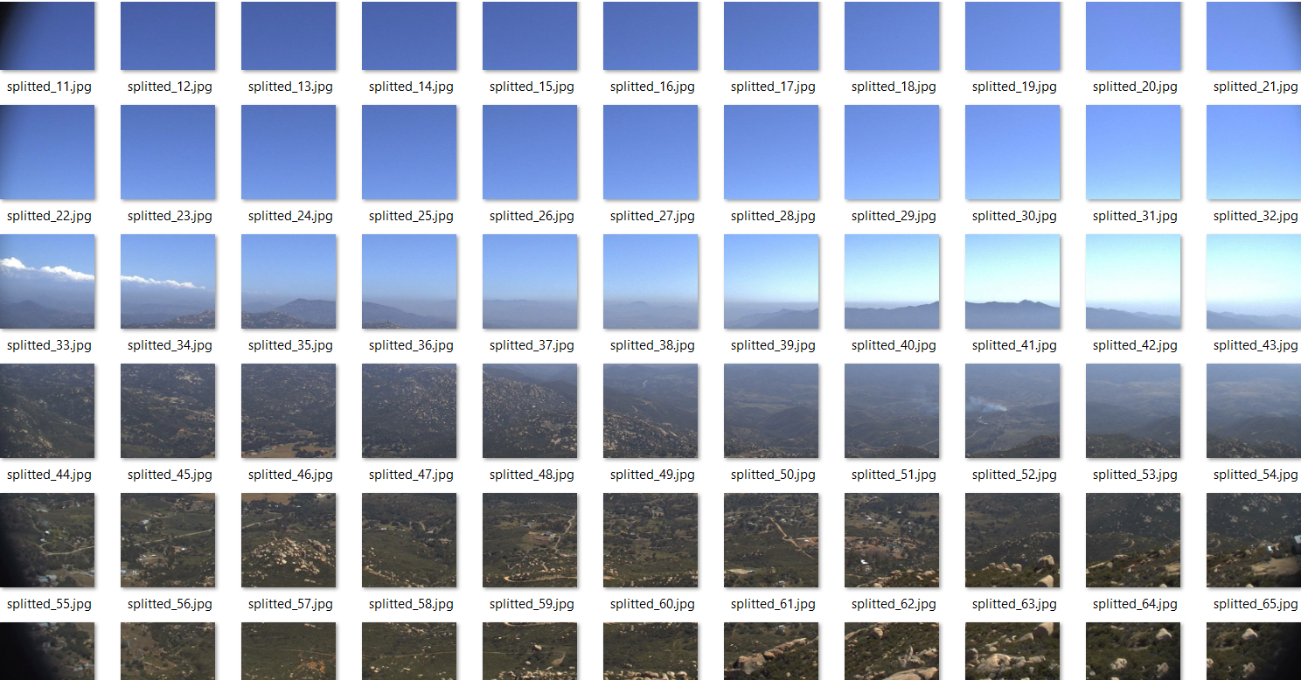

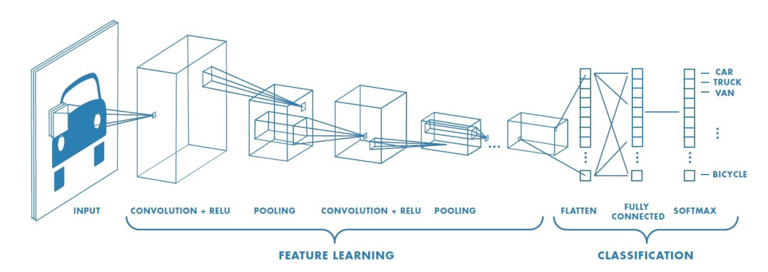
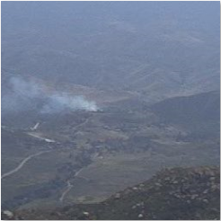
Early Wildfire Image Classification Convolutional Neural Network
http://hpwren.ucsd.edu/HPWREN-FIgLib/HPWREN-FIgLib-Data/20170708_Whittier_syp-n-mobo-c/20170708-Whittier-syp-n-mobo-c.mp4
Full 3072 x 2048
pixel image
SMOKE
NO
SMOKE
~70 299 x 299
sub images
SIGMOID
299 x 299
pixel sub image
(FILTER, DETECT, CONDENSE)
Notes:
To do this, I trained a convolutional neural network to identify images of early wildfire ignition events and then deployed it as part of a prototype that applies the neural network to new images coming in from one of the AlertWildfire cameras.
The way it works is we grab an image, like this one from the beginning of the Whittier fire sequence video.
We then split those images into 299x299 pixel subimages and pass them to our convolutional neural net one at a time to train it to identify these specific features.

Slide 6
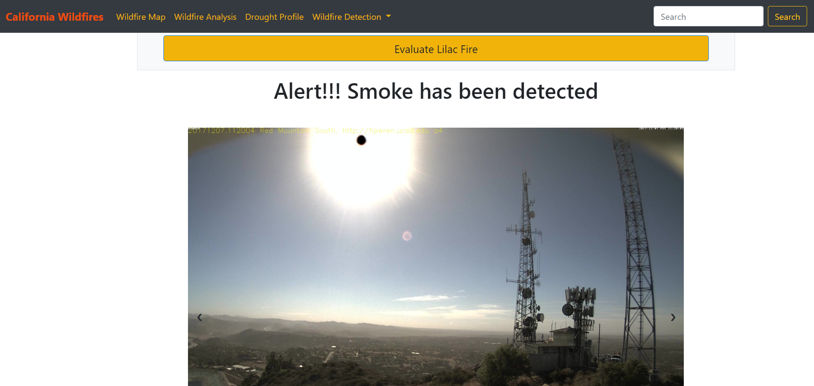
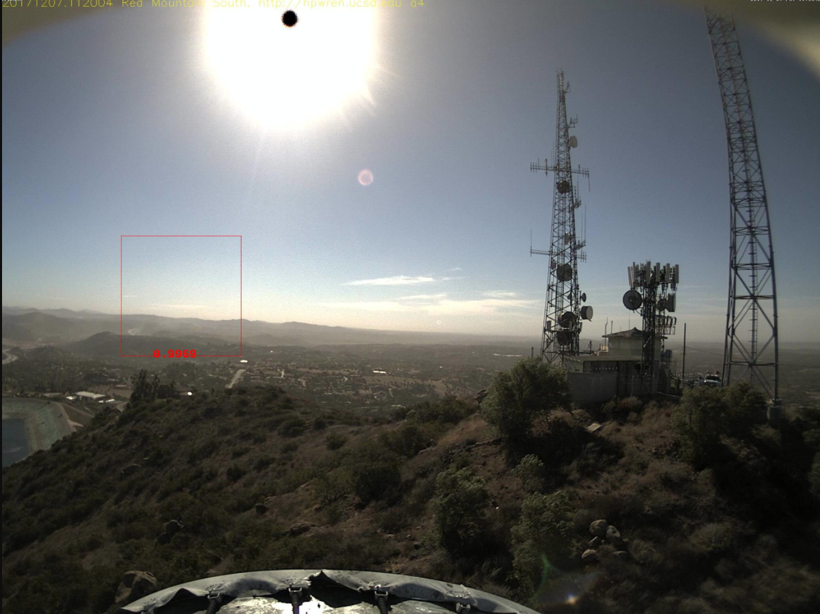
Notes:
At runtime, the model evaluates new images that are passed to it and classifies them according to whether they contain the small plumes of smoke that characterize early wildfire ignition events…..as you can see here in a screenshot of the web demo.

Slide 7
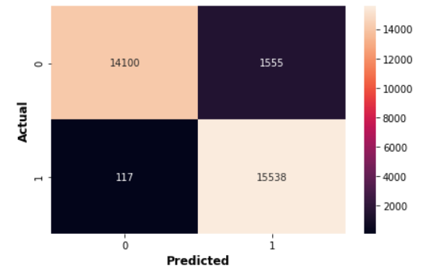
Results & Next Steps
True Accuracy 94.66%
True Positives: 49.63%
True Negatives: 45.03%
False Positives: 4.97%
False Negatives: 0.37%
The results clearly demonstrate that the technology could be used effectively for early detection of wildfires.
In densely populated California, most fires are reported within 15 minutes of ignition. Detecting a fire 10 minutes earlier can make a huge difference in terms of the potential destructiveness of that fire!
Wildfires have a rapid forward rate of spread (FROS) when burning through dense, uninterrupted fuels – they can move as fast as 6mph in forests and 14 mph in grasslands.
I plan to train a new version of the neural net in the near future with a dataset of 35,000 images expressly created to improve the false positive rate.
Confusion Matrix
Notes:
The results clearly demonstrate that the technology could be used effectively for early detection of wildfires.
The deployed version of the model accurately identifies early wildfires 95% of the time, but I have created a new dataset of 35,000- images specifically to improve the false positive rate and plan to train a new version of the neural network with it soon.

